Slide 1
Python

Slide 2

Python.org https://www.python.org/

Slide 3
> python -V
Python 3.14.0
> pip -V
pip 25.3 from C:\Python\Python314\Lib\site-packages\pip (python 3.14)

Slide 4
Python
Python is a high-level, general-purpose programming language; its design philosophy emphasizes code readability with use of significant indentation
Python is dynamically type-checked and garbage-collected; supports multiple programming paradigms, including structured (particulary proce - dural), object-oriented and functional programming
Guido van Rossum began working on Python in late 1980s Python 3.0, was major revision and not completely backward-compatible with earlier vers.
Python has gained widespread use in the machine learning community; it is widely taught as introductory programming language
since 2000, Python has consistently ranked in top ten of most popular programming languages in the Programming Community Index

Slide 5
pip
pip is a package manager (package management system) written in Python and is used to install and manage software packages
the Python Software Foundation recommends using pip to install Python applications and its dependencies during deployment
connects to an online software repository of public packages, named the Python Package Index (PyPI); can be configured to connect to other package repositories (local or remote), provided that they comply to Python Enhancement Proposal
most distributions of Python come with pip preinstalled, Python 3.4 and later include pip by default

Slide 7
in-memory database

Slide 8
to create an in-memory database, use the special filename
import sqlite3
conn = sqlite3.connect(':memory:’)

Slide 9
Advantages of In-Memory Databases
Extremely fast read and write operations
No disk I/O overhead
Useful for temporary data storage and processing
Use Cases for In-Memory Databases
Caching frequently accessed data
Temporary data storage for complex calculations or data transformations
Testing and development environments where persistence is not required

Slide 10
Limitations of In-Memory Databases
Data is lost when the connection is closed or the program terminates
Limited by available RAM
Not suitable for scenarios requiring data persistence

Slide 11
DataBase execution interval
on Disk storage was 2.838536024093628
in Memory storage was 0.052251577377319336

Slide 12
inMemory.py
with sqlite3.connect ('exampleDisk.db') as conn:
with sqlite3.connect (':memory:') as conn:

Slide 13
inMemory.py
import time
import sqlite3
# Connect to a database (or create it if it doesn't exist)
mployee_data = [
('Mirna', 'Burkin', 73, 'F', 4542.46),
('Sherman', 'Livezey', 76, 'M', 5228.15),
('Katusha', 'Van der Kruijs', 109, 'F', 4080.52),
('Barbie', 'Mahaddie', 73, 'F', 5073.8),
('Elvira', 'Pinwell', 37, 'F', 6045.1),
('Rodolphe', 'Scoyne', 52, 'M', 8238.47),
]

Slide 14
inMemory.py
start = time.time()
with sqlite3.connect('exampleDisk.db') as conn:
# Perform database operations here
conn.autocommit = True

Slide 15
inMemory.py
cursor = conn.cursor()
#Creating table as per requirement
sql = '''CREATE TABLE EMPLOYEE(
ID INTEGER PRIMARY KEY ,
FIRST_NAME TEXT NOT NULL,
LAST_NAME TEXT NOT NULL,
AGE INTEGER,
GENDER CHAR(1),
INCOME REAL,
UNIQUE ( FIRST_NAME, LAST_NAME ))'''
cursor.execute(sql)
conn.commit()
print("Table created successfully........")

Slide 16
inMemory.py
cursor.executemany('''
insert into EMPLOYEE (first_name, last_name, age, gender, income)
values (?, ?, ?, ?, ?);
''', employee_data)
conn.commit()
print("Records inserted........")

Slide 17
inMemory.py
# Perform database operations here
conn.row_factory = sqlite3.Row
cursor = conn.cursor()
cursor.execute('''SELECT * from EMPLOYEE''')
result = cursor.fetchall()
for row in result:
print(f"{row['FIRST_NAME']} {row['LAST_NAME']} is {row['AGE']} years old")
#Commit your changes in the database
conn.commit()

Slide 18
inMemory.py
conn.close()
end = time.time()
tdeltaDisk = end - start
print(f"on Disk storage DataBase execution interval was {tdeltaDisk}")

Slide 19
large datasets

Slide 20
Working with Large Datasets
employ efficient techniques for importing, querying, and indexing data
the SQLite command-line tool provides an .import command that can be used to import data from CSV files directly into table - method is useful for smaller datasets or when working directly in SQLite
for very large datasets, this method may not be the most efficient

Slide 21
for larger datasets, using Python to perform bulk inserts can be more efficient

Slide 22
largeDataSets.py
import sqlite3
import csv
with sqlite3.connect('car.db') as conn:
conn.autocommit = True
cursor = conn.cursor()
# Create the table (if it doesn't exist)
cursor.execute('''
CREATE TABLE IF NOT EXISTS car (
ID INTEGER PRIMARY KEY ,
CAR_MAKER TEXT NOT NULL,
CAR_MODEL TEXT NOT NULL,
COLOR TEXT NOT NULL,
TYPE TEXT NOT NULL)''' )

Slide 23
# Read the CSV file and insert data in batches
batch_size = 1000
data = []
with open('cars.csv', 'r') as file:
csv_reader = csv.reader(file)
next(csv_reader) # Skip header row
for row in csv_reader:
data.append((int(row[0]), row[1], row[2], row[3], row[4]))
if len(data) == batch_size:
cursor.executemany('''INSERT INTO car (id,
car_maker, car_model, color, type) VALUES (?, ?, ?, ?, ?)''', data)
data = []
conn.commit()

Slide 24
largeDataSets.py
# Insert any remaining data
if data:
cursor.executemany('''INSERT INTO car (id,
car_maker, car_model, color, type) VALUES (?, ?, ?, ?, ?)''', data)
conn.commit()
print("Records inserted........")
conn.close()

Slide 25
Use Appropriate Indexing
indexes can significantly improve query performance, especially for large datasets
create indexes on columns that are frequently used in WHERE clauses, JOIN conditions, or ORDER BY clauses
avoid over-indexing, as it can slow down INSERT, UPDATE, and DELETE operations
use composite indexes for queries that frequently filter on multiple columns together

Slide 26
loadTitanicCSV.py
import sqlite3
import csv
with sqlite3.connect('titanic.db') as conn:
conn.autocommit = True
cursor = conn.cursor()
# Create the table (if it doesn't exist)
cursor.execute('''
CREATE TABLE IF NOT EXISTS titanic (

Slide 27
loadTitanicCSV.py
PassengerId integer primary key ,
Survived integer , PClass integer ,
Name text , Sex text ,
Age real , SibSp integer ,
Parch integer , Ticket text ,
Fare real , Cabin text ,
Embarked text)'''
)
with open('titanic.csv', 'r') as file:

Slide 28
loadTitanicCSV.py
with open('titanic.csv', 'r') as file:
csv_reader = csv.reader(file)
next(csv_reader) # Skip header row
data = [(int(row[0]), int(row[1]), int(row[2]), row[3], row[4], row[5], int(row[6]), int(row[7]), row[8], float(row[9]), row[10], row[11]) \
for row in csv_reader]

Slide 29
loadTitanicCSV.py
cursor.executemany('''INSERT INTO titanic (
PassengerId, Survived, PClass, Name, Sex, Age,
SibSp, Parch, Ticket, Fare, Cabin , Embarked )
VALUES (?, ?, ?, ?, ?, ?, ?, ?, ?, ?, ?, ?)''', data)
conn.commit()
print("Records inserted........")
conn.commit()
conn.close()

Slide 30
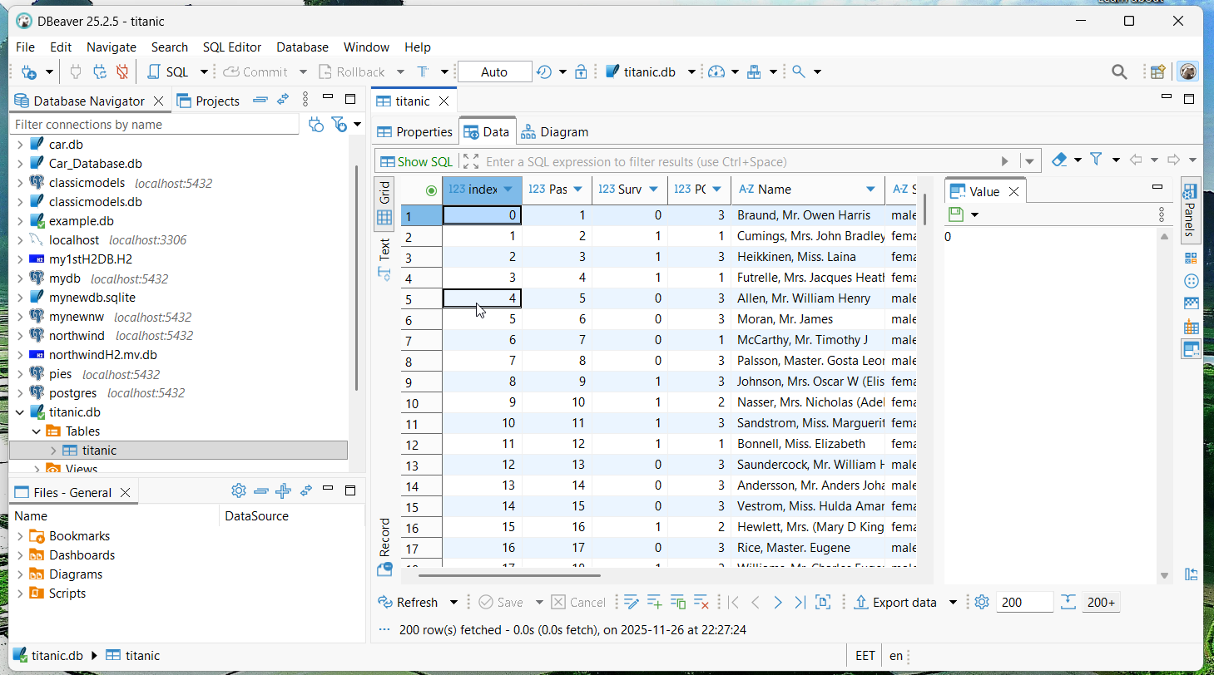

Slide 31
pandas

Slide 32
Pandas is a powerful data manipulation and analysis library for Python - combined with database, it provides robust toolkit for working with structured data
Pandas is built on top of NumPy and provides high-performance, easy-to use data structures and data analysis tools
primary data structures in Pandas are:
Series: a one-dimensional labeled array capable of holding any data type
DataFrame: a two-dimensional labeled data structure with columns of potentially different types

Slide 33
import numpy as np
import pandas as pd

Slide 34

NumPy https://numpy.org/
is a library for the Python programming language, adding support for large, multi-dimensional arrays and matrices, along with a large collection of high-level mathematical functions to operate on these arrays
NumPy is open-source software

Slide 35

pandas - Python Data Analysis Library https://pandas.pydata.org/
is a software library for the Python programming language for data manipulation and analysis - offers data structures and operations for manipulating numerical tables and time series
it is free software
introduced into Python many features of working with DataFrames
library is built upon another library, NumPy

Slide 36
pip install numpy
pip install pandas
pandas provides convenient functions for reading from and writing to SQLite databases

Slide 37
readDF.py
import pandas as pd
import sqlite3
# Connect to a database (or create it if it doesn't exist)
with sqlite3.connect('example.db') as conn:
# Perform database operations here
conn.autocommit = True
cursor = conn.cursor()
df = pd.read_sql_query("SELECT * FROM EMPLOYEE", conn)
# Close the connection
conn.close()

Slide 38
readDF.py
# Close the connection
conn.close()
# Display the first few rows of the DataFrame
print(df.head())

Slide 39
> python readDF.py
ID FIRST_NAME LAST_NAME AGE GENDER INCOME
0 1 Daniela CRUDU 27 F 9000.0
1 2 Nina ILIESCU 99 F 5000.0
2 3 Emil CONSTANTINESCU 89 M 6000.0
3 4 Traian BASESCU 78 M 7000.0
4 5 Klaus Werner JOHANNIS 67 M 8000.0

Slide 40
writeDF.py
import pandas as pd
import sqlite3
# Create a sample DataFrame
data = {
'name': ['Alexandru', 'Bogdan', 'Calin'],
'age': [25, 30, 55],
'city': ['New York', 'San Francisco', 'Los Angeles']
}
df = pd.DataFrame(data)

Slide 41
# Connect to the SQLite database
with sqlite3.connect('example.db') as conn:
# Perform database operations here
conn.autocommit = True
cursor = conn.cursor()
# Write the DataFrame to a new table
df.to_sql('people', conn, if_exists='replace', index=False)
print("Records inserted........")
conn.commit()
# Close the connection
conn.close()

Slide 42
print(df)
name age city
0 Alexandru 25 New York
1 Bogdan 30 San Francisco
2 Calin 55 Los Angeles

Slide 43
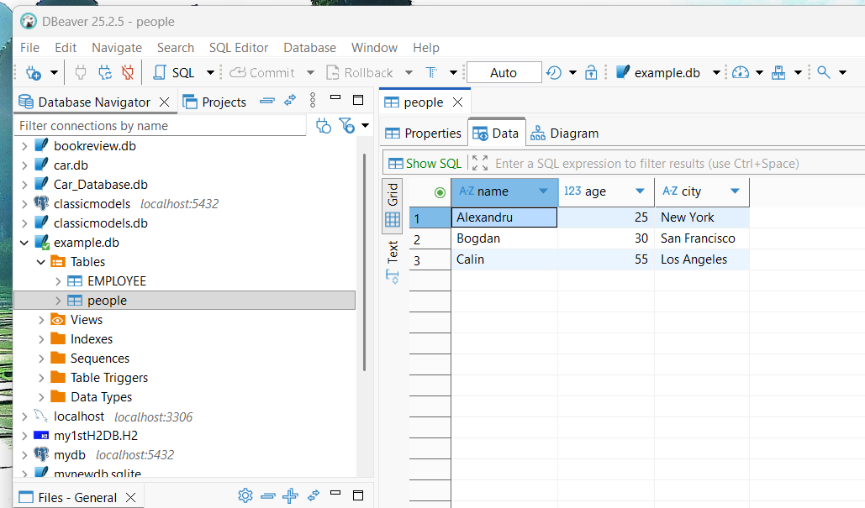

Slide 44
the if_exists parameter in to_sql() can be set to:
  'fail': raise a ValueError if the table exists (default)
  'replace': drop the table before inserting new values
  'append': insert new values to the existing table

Slide 45
loadTitanicJSON.py
import pandas as pd
import sqlite3
df = pd.read_json('titanic.json')
# Connect to the SQLite database

Slide 46
loadTitanicJSON.py
with sqlite3.connect('titanic.db') as conn:
# Perform database operations here
conn.autocommit = True
cursor = conn.cursor()
# Write the DataFrame to a new table
df.to_sql('titanic', conn, if_exists='replace')
print("Records inserted........")
conn.commit()
# Close the connection
conn.close()

Slide 47
print(df)
> python loadTitanicJSON.py
PassengerId Survived PClass ... Fare Cabin Embarked
0 1 0 3 ... 7.2500 S
1 2 1 1 ... 71.2833 C85 C
2 3 1 3 ... 7.9250 S
3 4 1 1 ... 53.1000 C123 S
.. ... ... ... ... ... ... ...
889 890 1 1 ... 30.0000 C148 C
890 891 0 3 ... 7.7500 Q
[891 rows x 12 columns]
Records inserted........

Slide 49
Data Analysis with Pandas and SQLite

Slide 50
Filtering Data

Slide 51
filterDF.py
import pandas as pd
import sqlite3
# Connect to a database (or create it if it doesn't exist)
with sqlite3.connect('titanic.db') as conn:
# Perform database operations here
conn.autocommit = True
cursor = conn.cursor()
df = pd.read_sql_query("SELECT * FROM titanic", conn)
# Close the connection
conn.close()

Slide 52
filterDF.py
# Filter rows based on a condition
minors = df[df['Age'] < 18]
print("minors")
for index, row in minors.iterrows():
print(f"{row['Name']}, Age {row['Age']}")
# Filter rows based on multiple conditions
poor_girls = df[(df['Age'] < 18) & (df['Sex'] == 'female') & (df['Fare'] < 10)]
print("poor girls")
for index, row in poor_girls.iterrows():
print(f"{row['Name']} {row['Age']} year - Fare: {row['Fare']}")

Slide 53
> python filterDF.py
minors
Palsson, Master. Gosta Leonard, Age 2.0
Nasser, Mrs. Nicholas (Adele Achem), Age 14.0
…
Najib, Miss. Adele Kiamie "Jane", Age 15.0
poor girls
Vestrom, Miss. Hulda Amanda Adolfina 14.0 year - Fare: 7.8542000000000005
McGowan, Miss. Anna "Annie" 15.0 year - Fare: 8.0292
…
Najib, Miss. Adele Kiamie "Jane" 15.0 year - Fare: 7.225

Slide 54
Basic Statistics
Grouping and Aggregation

Slide 55
staTitanic.py
import pandas as pd
import sqlite3
# Connect to a database (or create it if it doesn't exist)
with sqlite3.connect('titanic.db') as conn:
# Perform database operations here
conn.autocommit = True
cursor = conn.cursor()
df = pd.read_sql_query("SELECT * FROM titanic", conn)
# Or, if you want to read an entire table
# Close the connection
conn.close()

Slide 56
staTitanic.py
survived0 = df[df['Survived'] == 0]
survived1 = df[df['Survived'] == 1]
print(f"There were {df['PassengerId'].count()} on Titanic \
and only {survived1['PassengerId'].count()} survived.")
# Group by multiple columns and perform multiple aggregations
result = df.groupby(['Survived', 'Sex']).agg({
'Age': ['count', 'min', 'mean', 'median', 'max'],
'Fare': ['count', 'mean', 'median'] })
print(result)

Slide 57
staTitanic.py
px = 100 * ((result['Fare']['count'].loc[1, 'female'] + result['Fare']['count'].loc[1, 'male']) / \
(result['Fare']['count'].loc[1, 'female'] + result['Fare']['count'].loc[0, 'female'] \
+ result['Fare']['count'].loc[1, 'male'] + result['Fare']['count'].loc[0, 'male']))
pxf = 100 * ((result['Fare']['count'].loc[1, 'female']) / \
(result['Fare']['count'].loc[1, 'female'] + result['Fare']['count'].loc[0, 'female']))
pxm = 100 * ((result['Fare']['count'].loc[1, 'male']) / \
(result['Fare']['count'].loc[1, 'male'] + result['Fare']['count'].loc[0, 'male']))
print(f"{round(px, 2)}% survived")
print(f"{round(pxf, 2)}% female survived")
print(f"{round(pxm, 2)}% male survived")

Slide 58
> python staTitanic.py
There were 891 on Titanic and only 342 survived.
Age Fare
count min mean median max count mean median
Survived Sex
0 female 64 2.00 25.046875 24.5 57.0 81 23.024385 15.24580
male 360 1.00 31.618056 29.0 74.0 468 21.960993 9.41665
1 female 197 0.75 28.847716 28.0 63.0 233 51.938573 26.00000
male 93 0.42 27.276022 28.0 80.0 109 40.821484 26.28750
38.38% survived
74.2% female survived
18.89% male survived

Slide 59
(result['Fare']['count'].loc[1, 'female']

Slide 60
Merging DataFrames
if have multiple tables in database, can read them into separate DataFrames and merge them in Pandas

Slide 61
merged.py
import pandas as pd
import sqlite3
# Connect to a database (or create it if it doesn't exist)
with sqlite3.connect('northwind.db') as conn:
# Perform database operations here
conn.autocommit = True
cursor = conn.cursor()
products = pd.read_sql_query("SELECT * FROM products", conn)
categories = pd.read_sql_query("SELECT * FROM categories", conn)
merged_df = pd.merge(products, categories, on='category_id')

Slide 62
merged.py
# Close the connection
conn.close()
# Display the first few rows of the DataFrame
for index, row in merged_df.sort_values(by=['category_name', 'product_name']).iterrows():
print(f"{row['product_name']} of category: {row['category_name']}")

